Slide 1

Show of Hands
Kaggle Competition
Documented on August 18, 2015

Slide 2
Agenda
Problem Statement
Approach
Summary
Data Pre-processing
Data Modeling

Slide 3
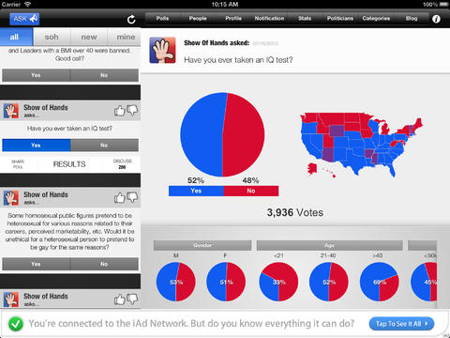
Show of Hands – Kaggle Competition
Problem Statement
Learn what predicts happiness by using informal polling questions
What predicts happiness? In this competition, you'll be using data from Show of Hands, an informal polling platform for use on mobile devices and the web, to see what aspects and characteristics of people's lives predict happiness.
Show of Hands has been downloaded over 300,000 times across Apple and Android app stores, and users have cast more than 75 million votes. In this problem, we'll use data from thousands of users and one hundred different questions to see which responses predict happiness

Slide 4
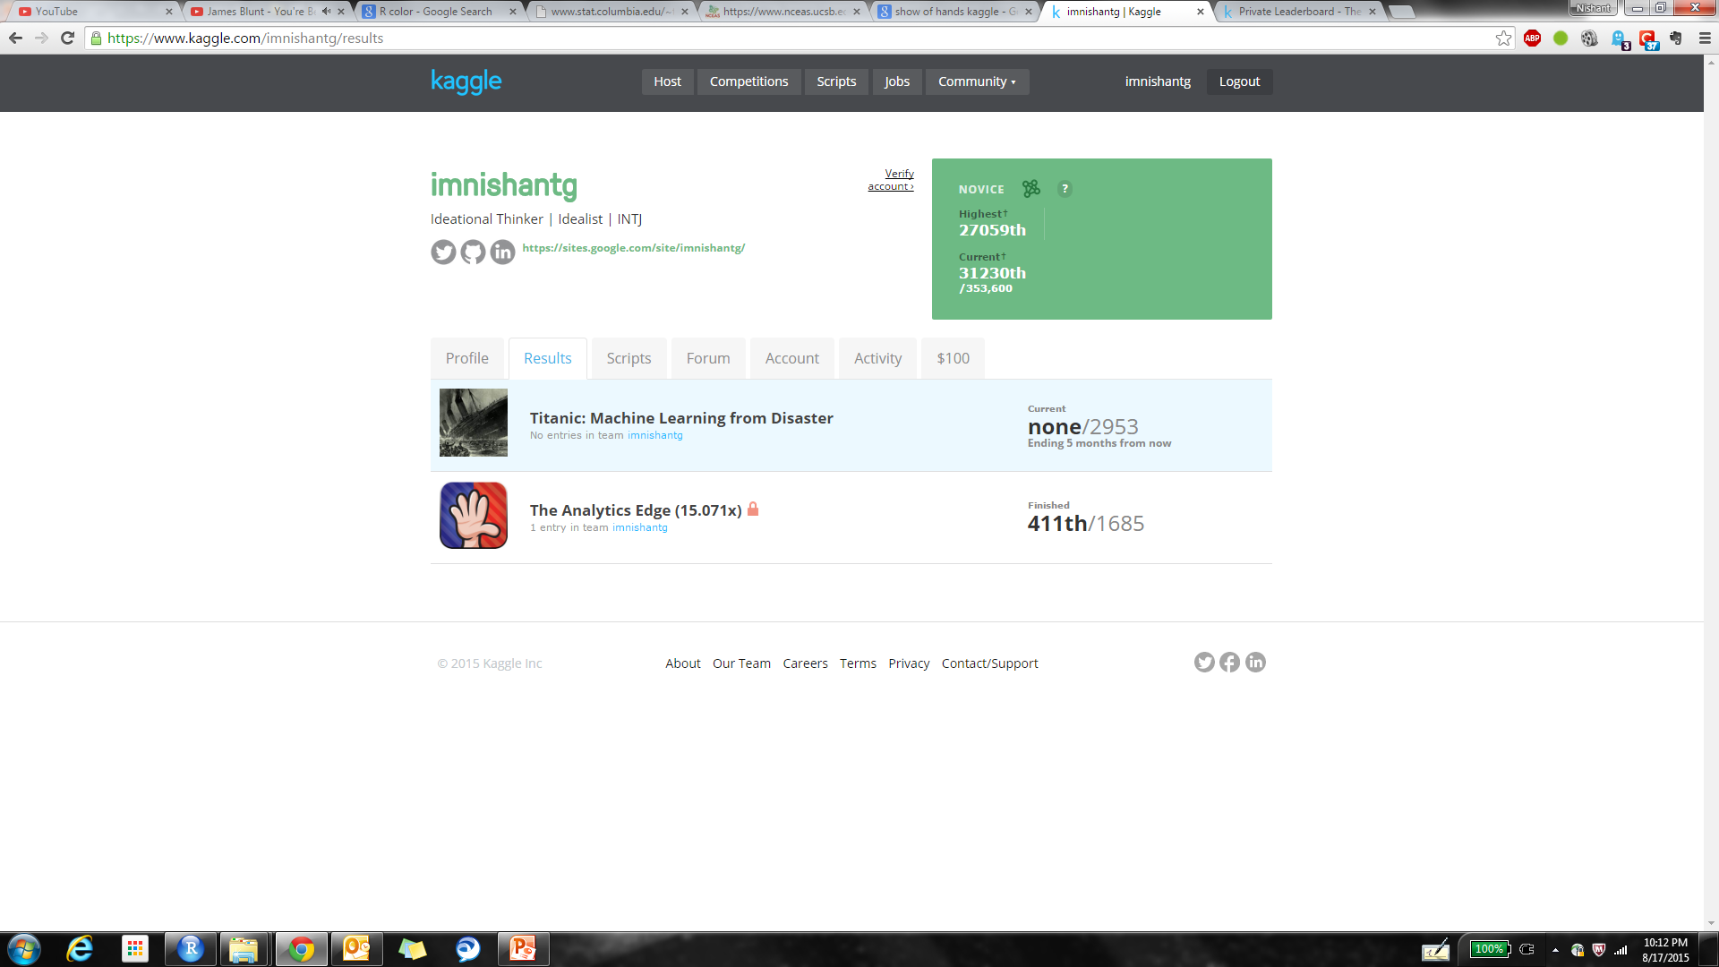
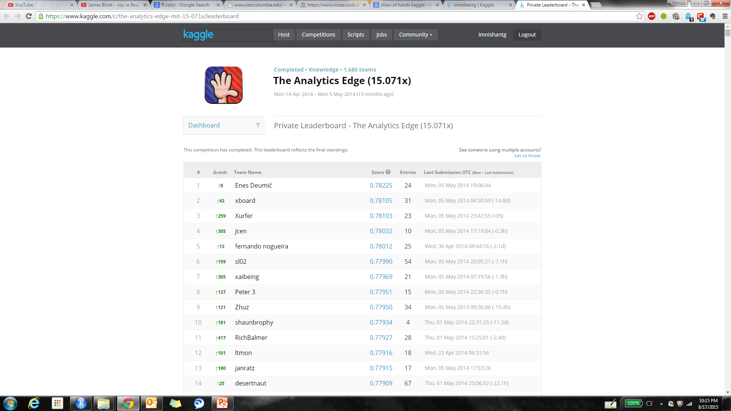
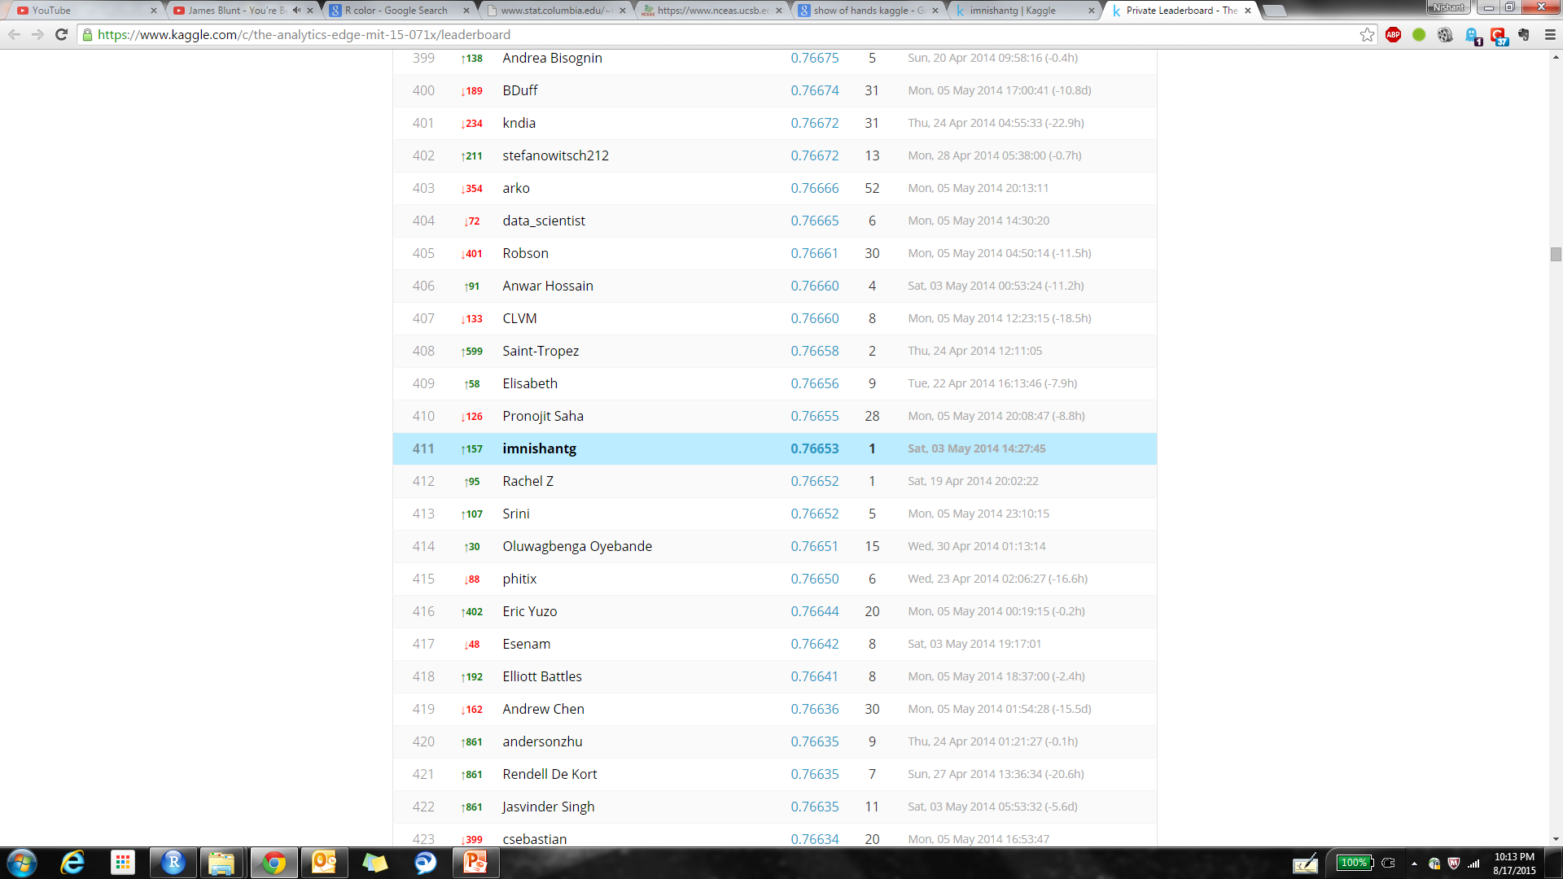
Show of Hands – Kaggle Competition
Competition Performance
Kaggle Competition Performance
Time of Competition: April – May 2014
Duration of Competition: 21 Days

Slide 5
Data Description
Data Description
File descriptions
train.csv - the training set of data that you should use to build your models (4,619 X 111)
test.csv - the test set that you will be evaluated on. It contains all of the independent variables, but not the dependent variable (1,980 X 111)
sampleSubmission.csv - a sample submission file in the correct format
Questions.pdf - the question test corresponding to each of the question codes, as well as the possible answers
Data fields
UserID - an anonymous id unique to a given user
YOB - the year of birth of the user
Gender - the gender of the user, either Male, Female, or not provided
Income - the household income of the user. Either not provided, or one of "under $25,000", "$25,001 - $50,000", "$50,000 - $74,999", "$75,000 - $100,000", "$100,001 - $150,000", or "over $150,000".
HouseholdStatus - the household status of the user. Either not provided, or one of "Domestic Partners (no kids)", "Domestic Partners (w/kids)", "Married (no kids)", "Married (w/kids)", "Single (no kids)", or "Single (w/kids)".
EducationLevel - the education level of the user. Either not provided, or one of "Current K-12", "High School Diploma", "Current Undergraduate", "Associate's Degree", "Bachelor's Degree", "Master's Degree", or "Doctoral Degree".
Party - the political party of the user. Either not provided, or one of "Democrat", "Republican", "Independent", "Libertarian", or "Other".
Happy - a binary variable, with value 1 if the user said they were happy, and with value 0 if the user said that were neutral or not happy. This is the variable you are trying to predict.
Q124742, Q124122, . . . , Q96024 - 101 different questions that the users were asked on Show of Hands. If the user didn't answer the question, there is a blank. For information about the question text and possible answers, see the file Questions.pdf.
votes - the total number of questions that the user responded to, out of the 101 questions included in the data set (this count does not include the happiness question).

Slide 6
Agenda
Problem Statement
Approach
Summary
Data Pre-processing
Data Modeling

Slide 7
Data Analyses Design
Data Analyses Design
High-level Data analyses process
Training set was used to train the models
Training Set
Raw Data
Processed Data
Training Set
Test Data
Best Model
F(X)
Validation Set
Raw data was pre-processed before splitting into training and validation set
Validation Set
The optimized model was then used to predict the patient states in the test data set
Validation Set was used to optimize/ tune the model hyper parameters to identify the best settings

Slide 8
Agenda
Problem Statement
Approach
Summary
Data Pre-processing
Data Modeling

Slide 9
Project Approach
Executive Summary
The first step in the data analysis process was data exploration
Basic data exploration helped us in identifying that dataset had a lot of missing values
Basic Insights were derived by using personal attributes of users in the dataset
Before the pre-processing step, training and test dataset were combined
In the data pre-processing step, we treated the missing values in personal attributes and question-based variables (discussed later) and created new features
Once pre-processing was done, training and test dataset were separated. Training dataset was then further processed by filtering out non-intuitive observations (e.g. YOB = 1900, 2039, etc.)
In the initial phase, models like Decision tree, random forest, and GBM were used to shortlist the variables that are important from the prediction perspective
The results from the initial phase was used to filter out non-essential variables and the final phase data modeling was done on a small subset of variables
Model that were tried in the final phase: Logistic Regression, Decision Tree, Random Forest, GBM, SVM, LDA, QDA, and Naïve Bayes

Slide 10
Project Summary
Executive Summary
GBM turns out to be the best model when model comparison is done on the basis of Area under the Curve for test dataset
When compared in terms of test error, Naïve Bayes (among stand-alone models) and Ensemble method (discussed later) are the best models for the problem
Test AUC
Test Error
Logistic Regression | Decision Tree | Random Forest | Gradient Boosting Machine | Support Vector Machine | Linear Discriminant Analysis | Naïve Bayes
0.753 | 0.692 | 0.732 | 0.763 | 0.757 | 0.753 | 0.751

Slide 11
Agenda
Problem Statement
Approach
Summary
Data Pre-processing
Data Evaluation
Pre-processing
Basic Insights
Data Modeling

Slide 12
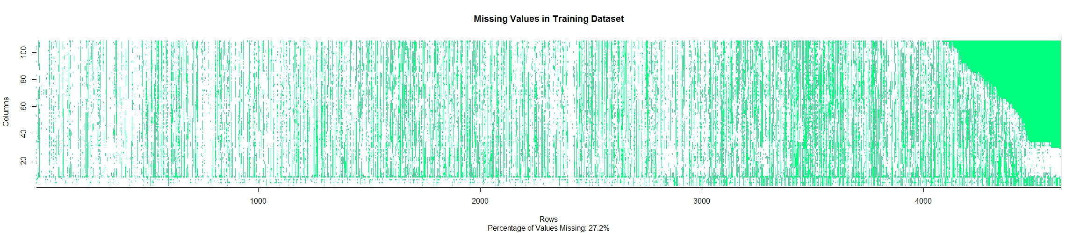
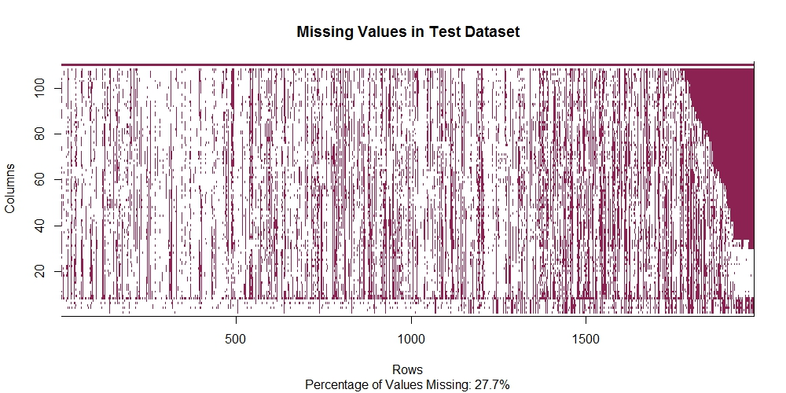
More than 27% of the data is missing in the training and test dataset, which makes handling of missing values extremely important
Dataset Evaluation – Missing Values (1/2)
The Green and Red portion of the dataset map represents the missing values in the dataset
While training data has 27.2% of its values missing, 27.7% of the data is missing from the test set

Slide 13
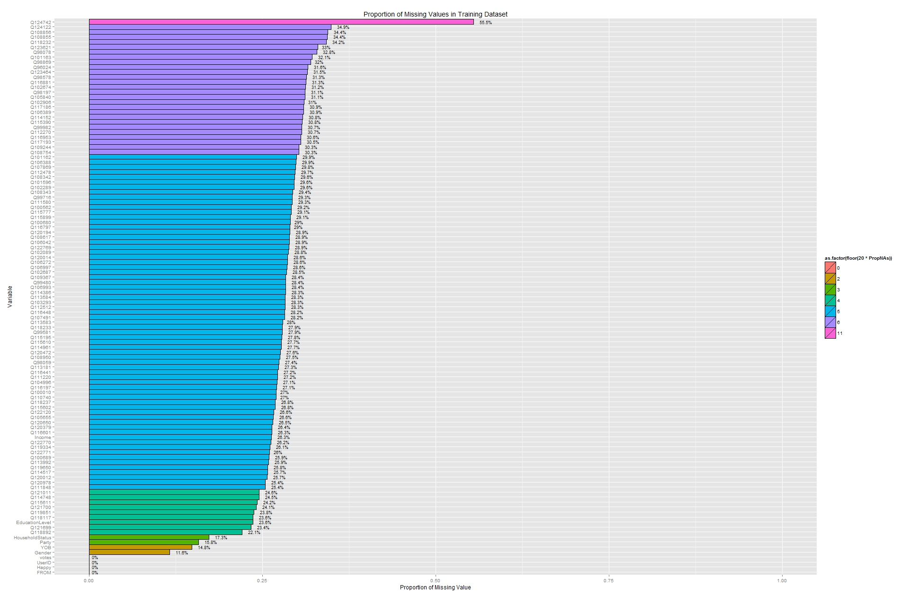
Most of the variables have 25-30% of their values missing, which makes it very difficult to omit all such observations / variables
Dataset Evaluation – Missing Values (2/2)
Most of the variables have more than 20% of their data missing
Fundamentally, there are two kinds of variables:
Personal Attributes
Question-Based
The method of handling missing values is different for each of such case
Personal Attributes:
Multiple Imputation was performed for these variables wrt to all the other personal attributes variables.
K-nearest neighbor imputations was used to predict the missing values in personal attributes variables
Question-Based:
Missing values in such variables can indicate that user did not answer this questions, either knowingly or unknowingly.
Missing values in such variables were recoded as “Skipped”
30 – 35%
25– 30%
20– 25%

Slide 14
Feature Generation
Feature Generation
Most of the variables of categorical ‘Questions-Based’ type and hence did not require feature generation
However, ‘Personal Attributes’ variables were used to create new features
YOB (Year of Birth) → Age
HouseholdStatus → MarriageStatus, Kids

Slide 15
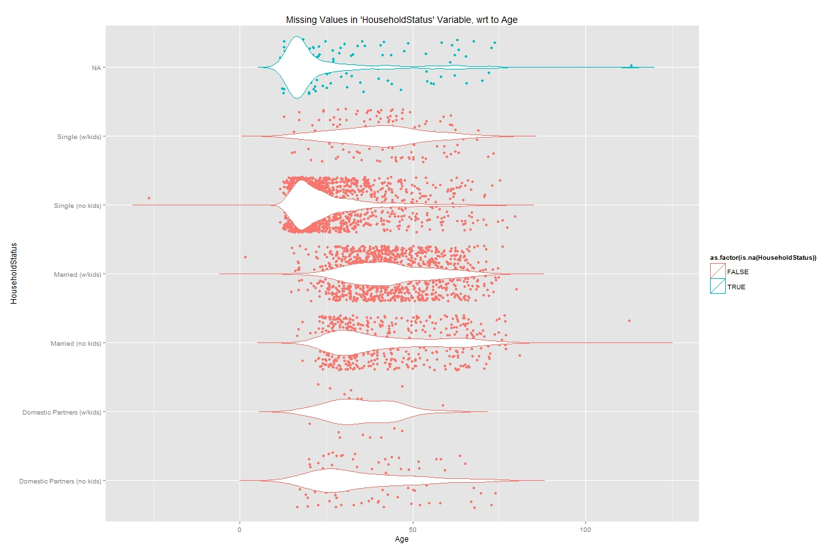
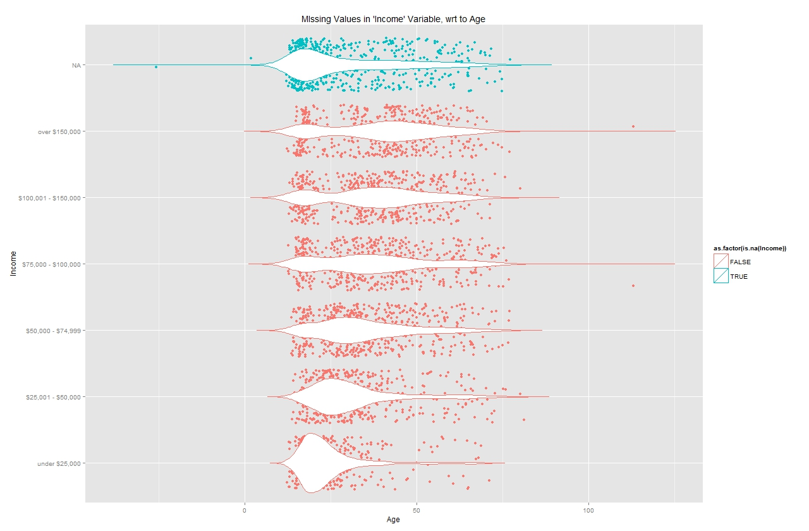
17% of the data in ‘HouseholdStatus’ column is missing, while for 27% of the data is missing for ‘Income’ column
Dataset Evaluation – Basic Insights (1/2)
Missing Values in “HouseholdStatus” wrt Age
Missing Values in “Income” wrt Age
The data makes intuitive sense, as:
Age(Single with no Kids) < Age(Married with no Kids) < Age(Married with Kids)
For a higher income bracket, average age has an increasing trend

Slide 16
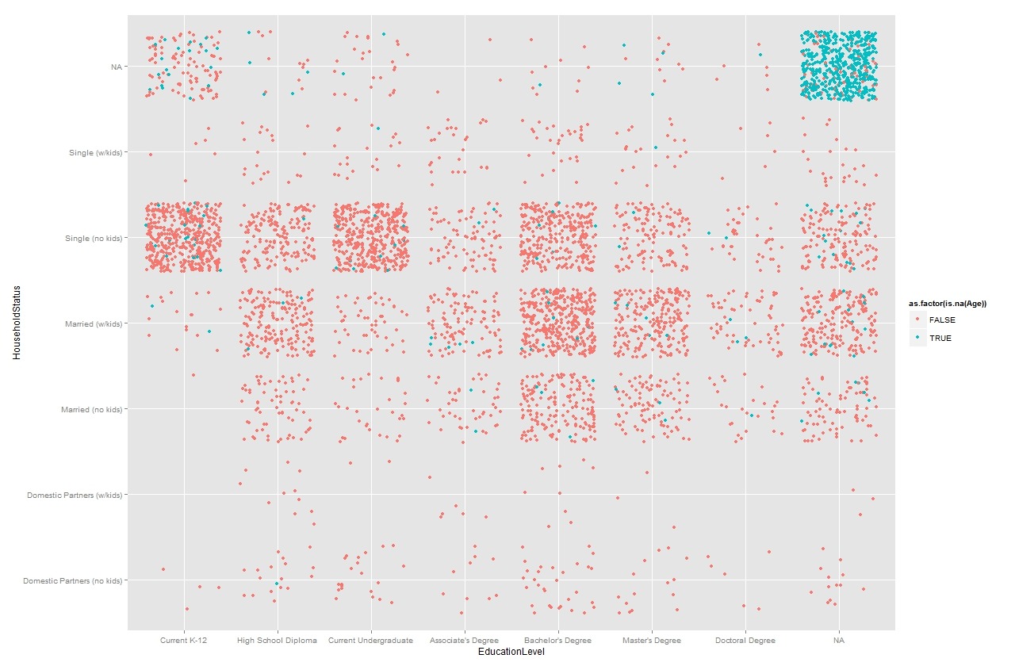
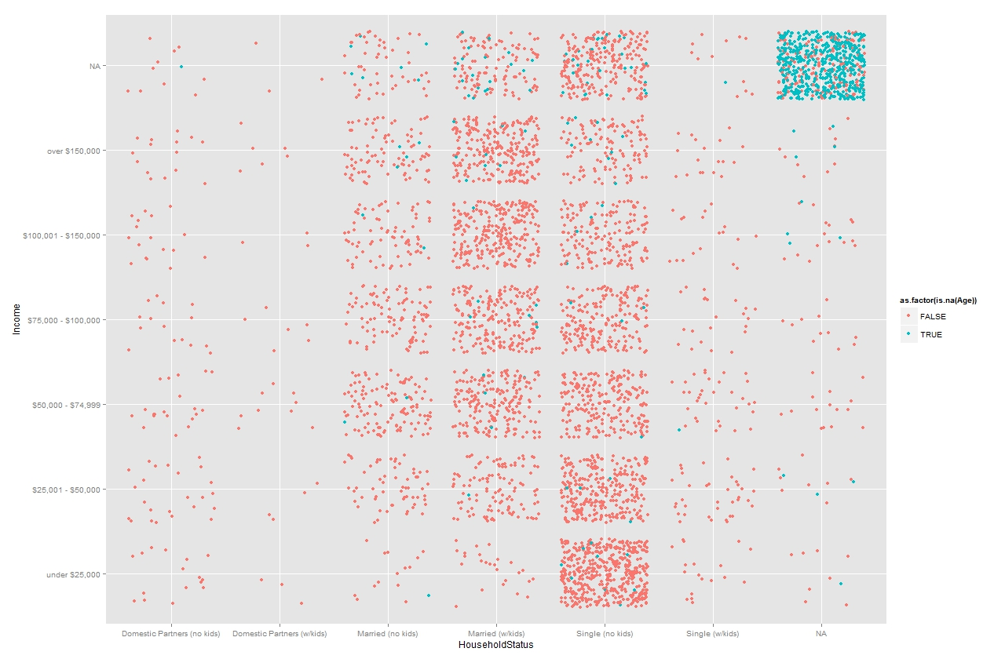
In most of the cases, the data for ‘Age’ variable in missing along with the other personal attributes data
Dataset Evaluation – Basic Insights (2/2)
Distribution of Age by ‘Education Level’ and ‘Household Status’
Distribution of Age by ‘Income’ and ‘Household Status’
Majority of the users (featured in the dataset) are either Single (without Kids) or Married

Slide 17
Agenda
Problem Statement
Approach
Summary
Data Pre-processing
Data Modeling
Determination of Significant Variables
Data Modeling on Significant Variables

Slide 18
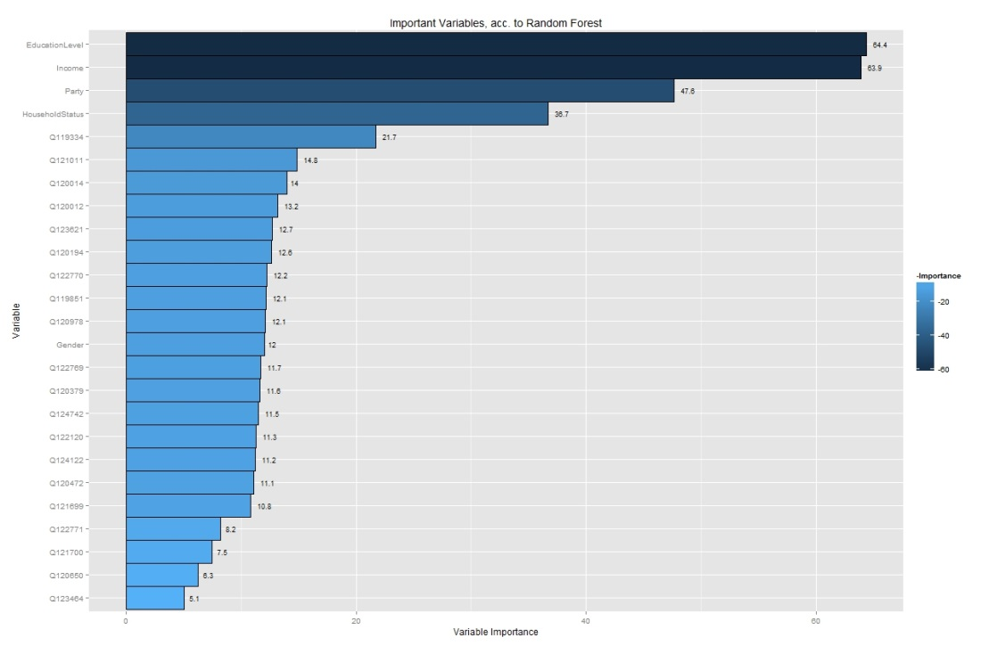
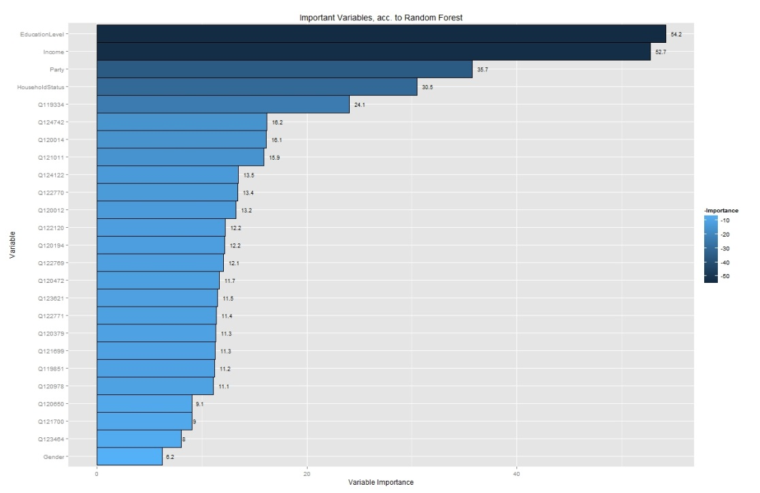
Random Forest (with All Variables)
Random Forest | All Variables
Random Forest Algorithm was used to:
Narrow down number of variables (to be used in final model)
Determine the most important variables among 108 variables
Random Forest Model I:
Dataset: Without treating the missing values
Random Forest Model II:
Dataset: After treating the missing values (as discussed before)
Personal Attributes variables feature among the topmost important variables, followed by a set of Question-Based variables that occur in both the random forest models

Slide 19
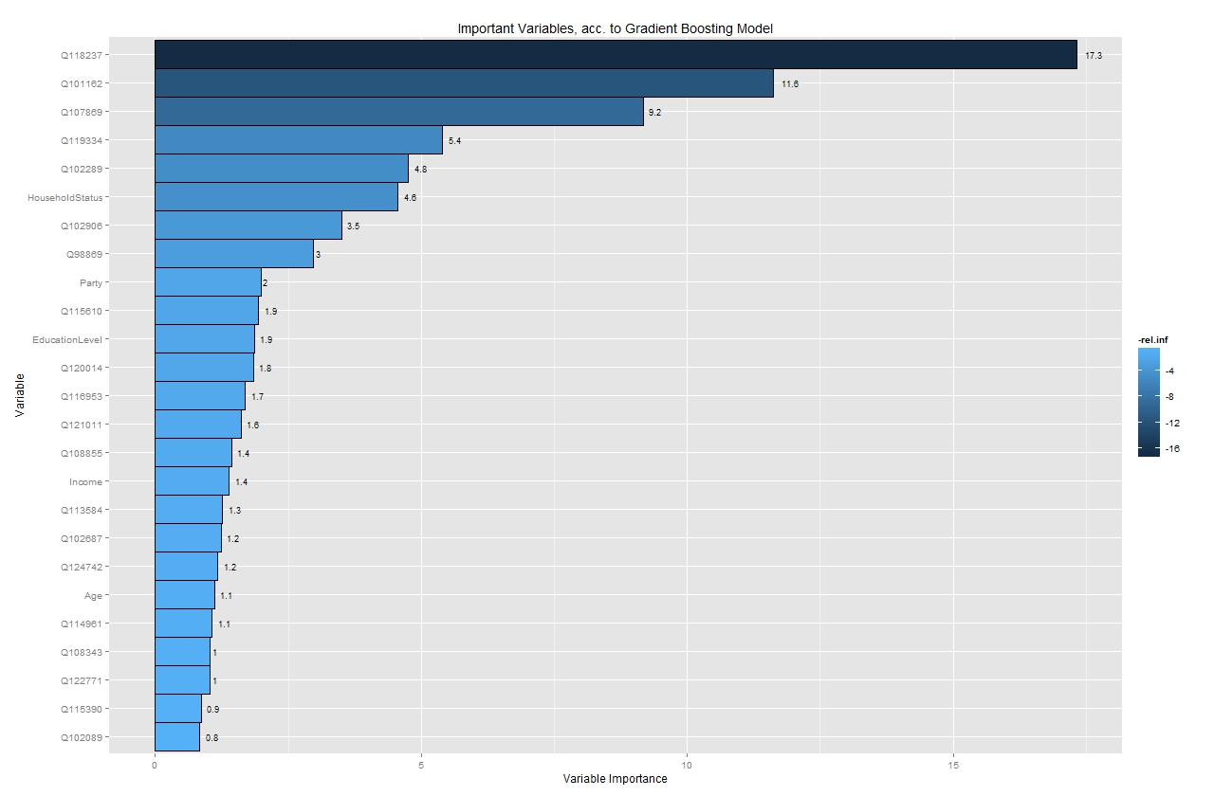
Gradient Boosting Machine (with All Variables)
Gradient Boosting Machine | All Variables
In addition to random forest models, gradient boosting machine was also used to:
Narrow down number of variables (to be used in final model)
Determine the most important variables among 108 variables
Gradient Boosting Machine
In contrast to what was observed in the random forest models, the top most significant variables are not ‘Personal Attributes’ variables but ‘Question-Based’ variables.
Although, majority of Personal attribute variables do feature among the top 25 variables

Slide 20
Determination of Significant Variables
Significant Variables
Top 16 variables were selected based on their relative strength of prediction, as determined from machine learning methods like Random Forests and Gradient Boosting Machines
Random Forest
(Before processing missing values)
Random Forest
(After processing missing values)
20
20
16
20
Gradient Boosting Machine

Slide 21
Determination of Significant Variables
Significant Variables
Among the top 16 variables selected based on their relative strength of prediction, 5 were personal attribute variables whereas 11 variables were of Question-based type
Variable | Description
Age | Age (derived from ‘YOB’ variable)
EducationLevel | Education Level
Income | Income
Party | Party
HouseholdStatus | House Hold Status
Q118237 | Do you feel like you are "in over-your-head" in any aspect of your life right now
Q101162 | Are you generally more of an optimist or a pessimist
Q107869 | Do you feel like you're "normal"
Q119334 | Did you accomplish anything exciting or inspiring in 2013
Q102906 | Are you currently carrying a grudge against anyone in your personal life
Q102289 | Does your life feel adventurous
Q121011 | Changing or losing a job, getting married or divorced, the death of a close relative, moving, a major health issue, bankruptcy...all are life events that can create high stress for people. Have you experienced any of these in 2013
Q120014 | Are you more successful than most of your high-school friends
Q98869 | Does life have a purpose
Q108855 | Do you enjoy getting together with your extended family
Q115610 | Does the "power of positive thinking" actually work
Personal Attributes
Question Based

Slide 22
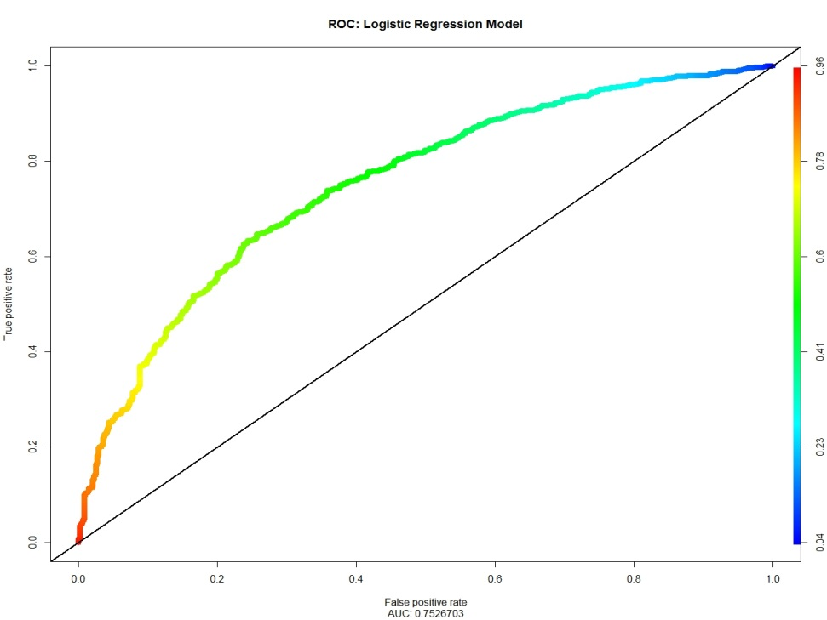
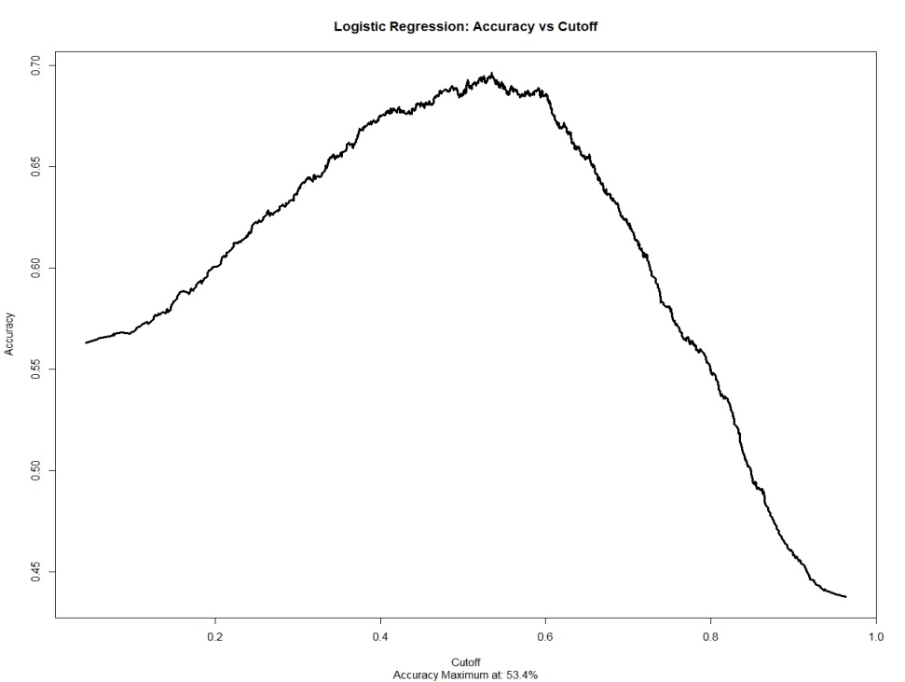
Logistic Regression
Logistic Regression | Results
Area under the ROC Curve: 0.753
Logistic Regression was applied to the dataset (using the glm function)
Prediction probabilities were calculated on the test dataset
The AUC value is among the highest of all the models tried.
Accuracy vs. Cutoff analysis suggest that maximum accuracy is achieved for cutoff of 53.4%. Although, as it is quite close to 50%, 0.5 was retained as cutoff for class prediction
ROC Curve: Logistic Regression Model
AUC: 0.753
Accuracy vs. Cutoff Curve: Logistic Regression Model
Maximum Accuracy at 53.4%

Slide 23
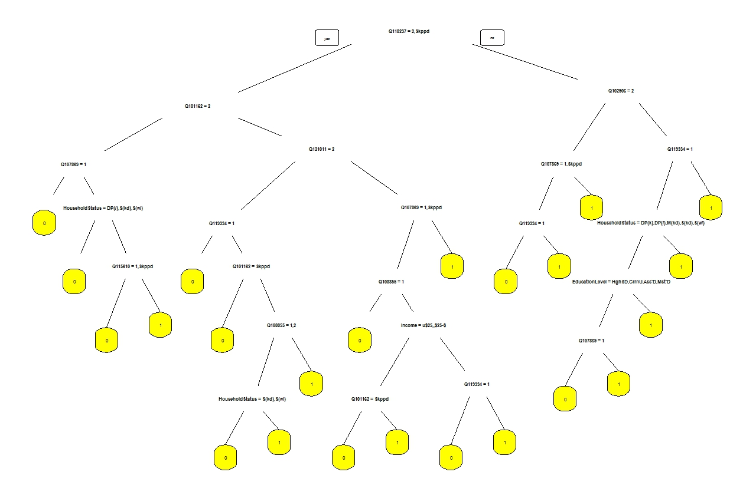
Decision Tree Model
Decision Trees | Trees
Decision Tree of Happiness
Decision Tree was not studied further as the AUC value was less than 0.7, a value that is easily achieved by majority of other methods

Slide 24
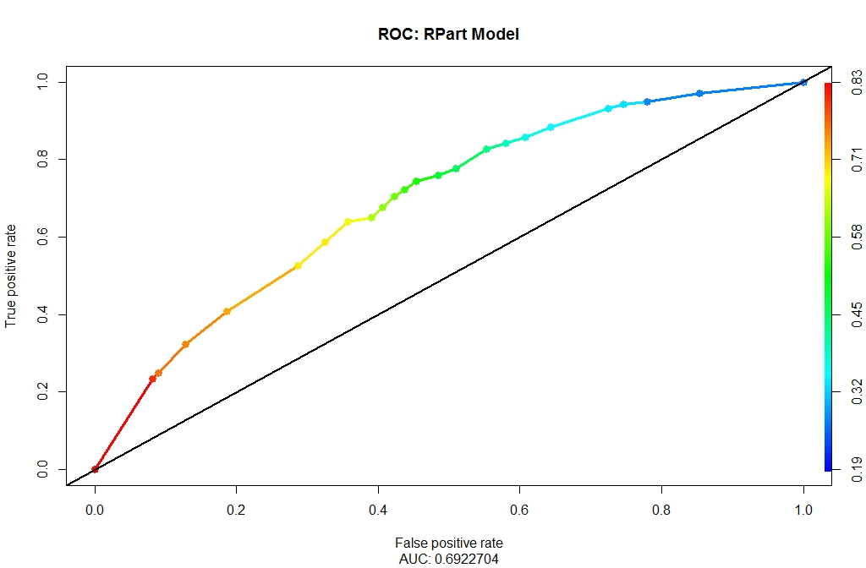
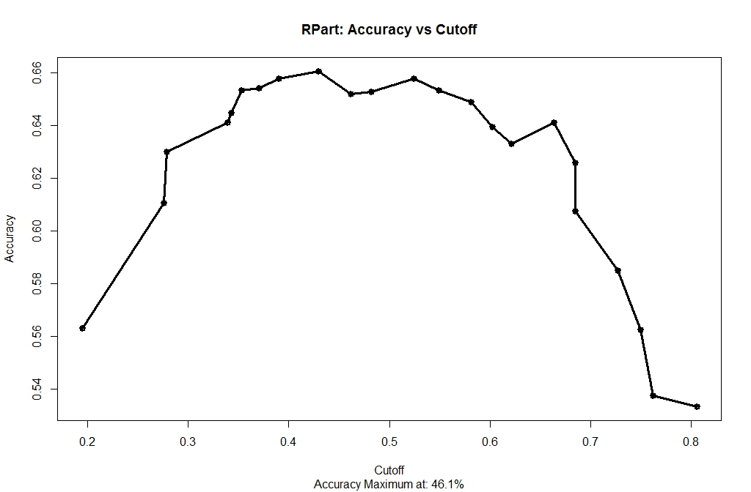
Decision Tree Model
Decision Tree Model | Results
Area under the ROC Curve: 0.692
Decision tree was applied to the dataset (using the rpart function)
Prediction probabilities were calculated on the test dataset
Pruning the tree did not yield better results. The AUC for decision tree model is among the lowest
ROC Curve: Decision Tree Model
AUC: 0.692
Accuracy vs. Cutoff Curve: Decision Tree Model
Maximum Accuracy at 46.1%

Slide 25
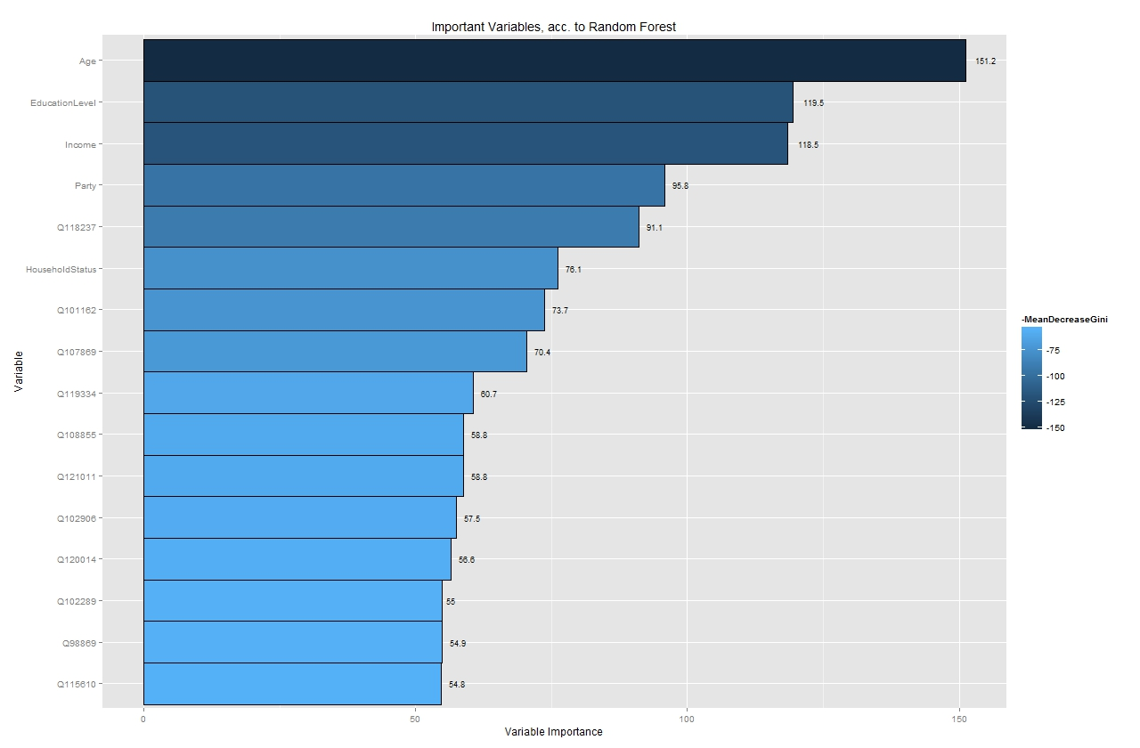
Random Forest
Random Forest | Results
The most important variables for predictions are personal attributes variables: Age, EducationLevel, and Income

Slide 26
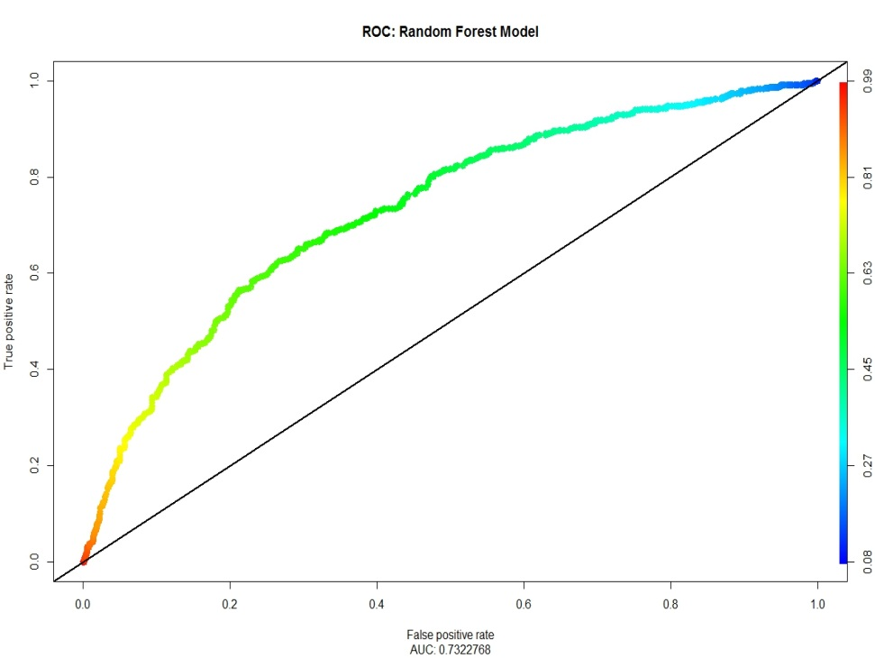
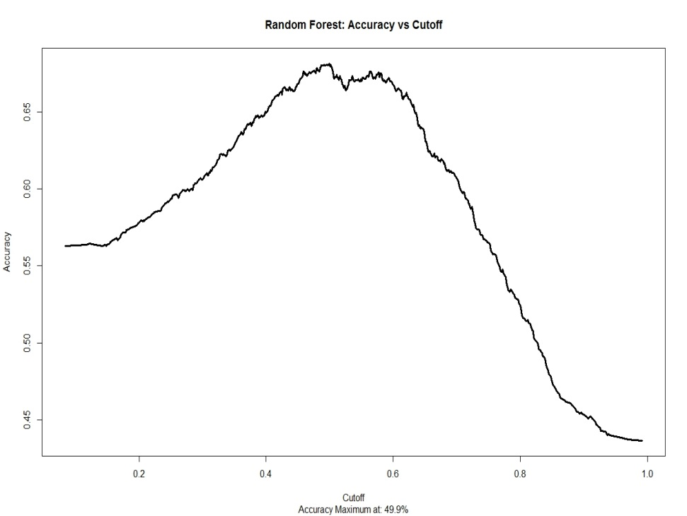
Random Forest
Random Forest | Results
Area under the ROC Curve: 0.732
Random Forest was applied to the dataset (using the randomForest function)
Best test AUC was determined by using cross-validation during grid-search on the following hyper-parameters
Number of Trees (Final Value: 1000)
M: Number of features tried (at random) before each split (Final Value: 2)
ROC Curve: Random Forest
AUC: 0.732
Accuracy vs. Cutoff Curve: Random Forest
Maximum Accuracy at 49.9%

Slide 27
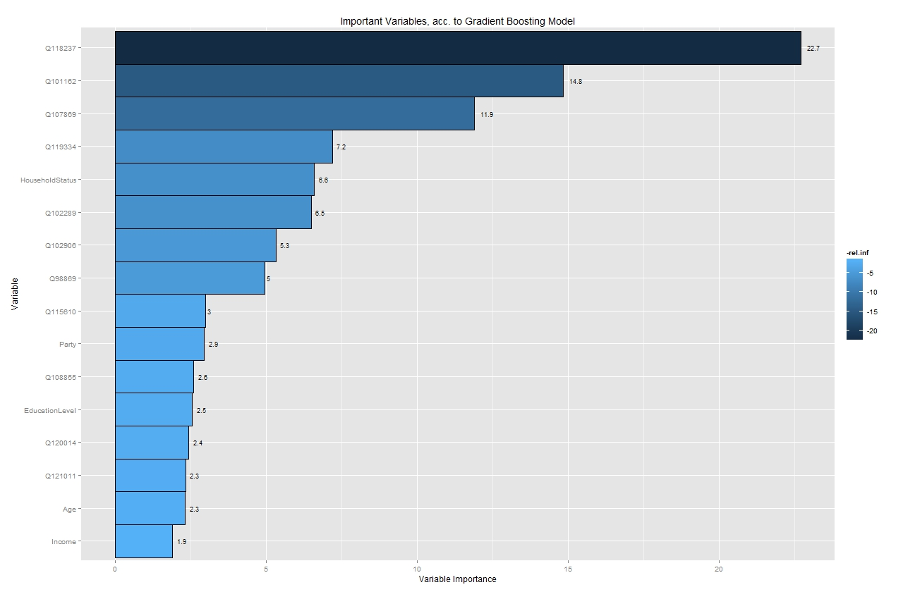
Gradient Boosting Machine
Gradient Boosting Machine | Results
The most important variables for predictions are Question-Based: Q118237, Q101162, and Q107869¹
Note: ¹Description for the questions are given in the Appendix

Slide 28
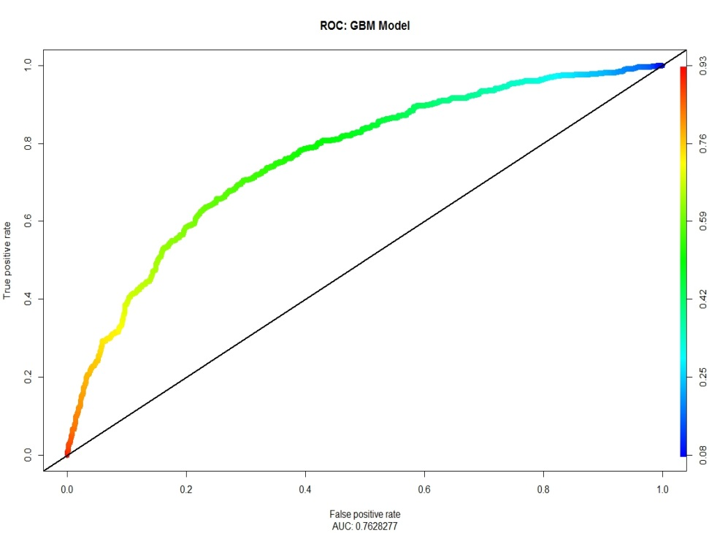
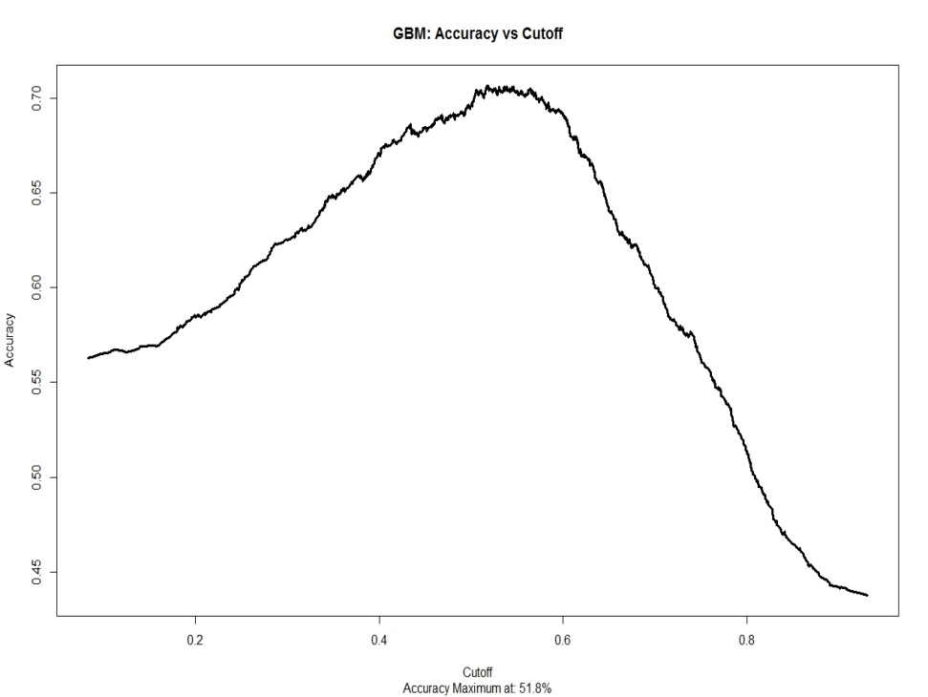
Gradient Boosting Machine
Gradient Boosting Machine | Results
Area under the ROC Curve: 0.763
Gradient Boosting Machine was applied to the dataset (using the gbm function)
Best test AUC was determined by using cross-validation during grid-search on the following hyper-parameters
Number of Trees (Final Value: 2000)
Shrinkage: (Final Value: 0.007)
Interaction Depth (Final Value: 1)
ROC Curve: Gradient Boosting Machine
AUC: 0.763
Accuracy vs. Cutoff Curve: Gradient Boosting Machine
Maximum Accuracy at 51.8%

Slide 29

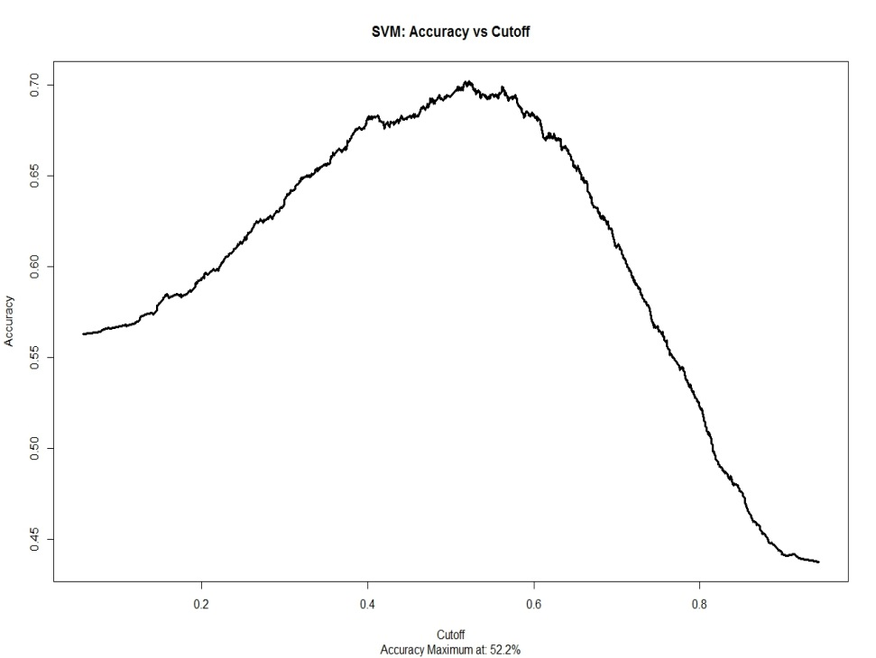
Support Vector Machine
Support Vector Machine | Results
Area under the ROC Curve: 0.757
Support Vector Machine was applied to the dataset (using the svm function)
Best test AUC was determined by using cross-validation during grid-search on the following hyper-parameters
Gamma (Final Value: 0.004)
Cost: (Final Value: 3.5)
ROC Curve: Support Vector Machine
AUC: 0.757
Accuracy vs. Cutoff Curve: Support Vector Machine
Maximum Accuracy at 52.2%

Slide 30

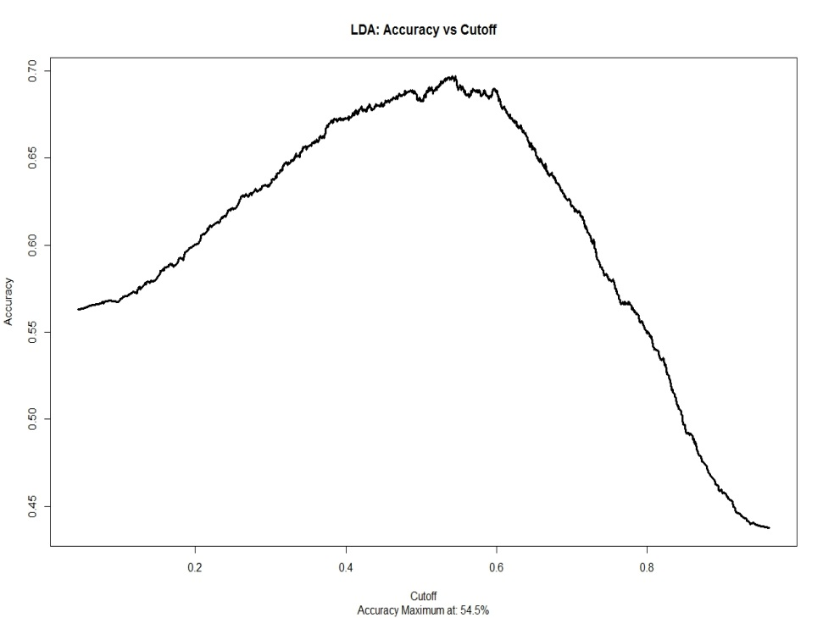
Linear Discriminant Analysis
Linear Discriminant Analysis | Results
Area under the ROC Curve: 0.753
Decision tree was applied to the dataset (using the rpart function)
Prediction probabilities were calculated on the test dataset
The prior probabilities used:
For 0: 0.437
For 1: 0.563
ROC Curve: Linear Discriminant Analysis
AUC: 0.753
Accuracy vs. Cutoff Curve: Linear Discriminant Analysis
Maximum Accuracy at 54.5%

Slide 31
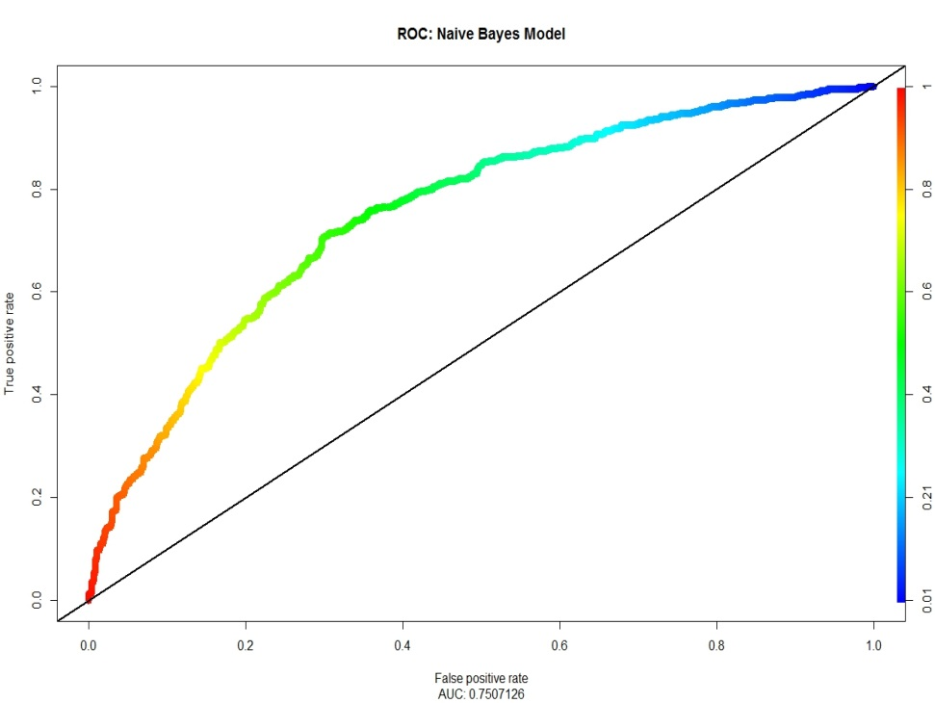
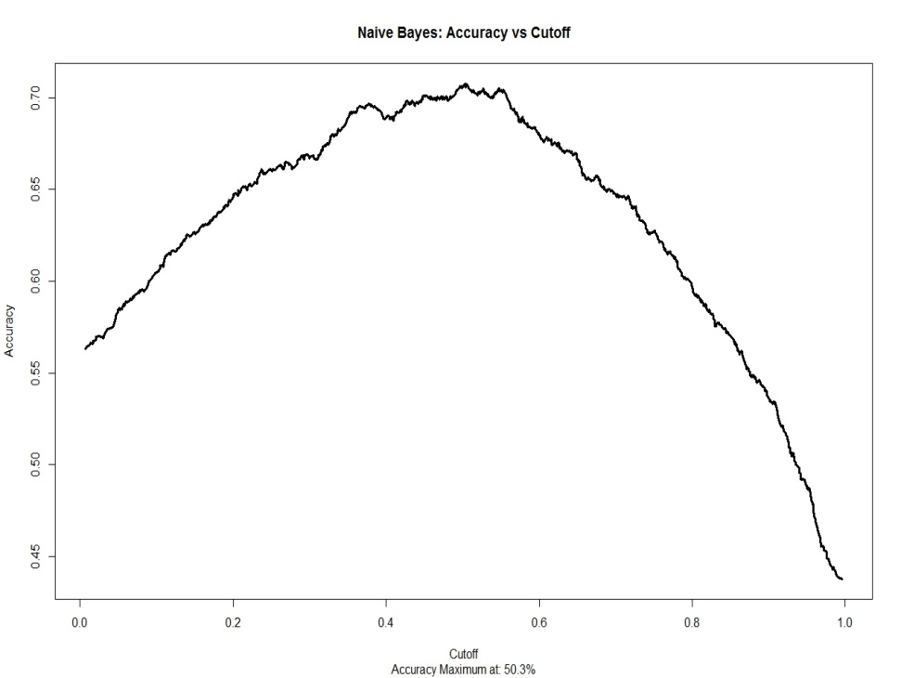
Naïve Bayes
Naïve Bayes | Results
Area under the ROC Curve: 0.751
Naïve Bayes was applied to the dataset (using the naiveBayes function)
Prediction probabilities were calculated on the test dataset
The AUC derived from the method is among the top 5 AUCs calculated in the problem
ROC Curve: Naïve Bayes
AUC: 0.751
Accuracy vs. Cutoff Curve: Naïve Bayes
Maximum Accuracy at 50.3%

Slide 32
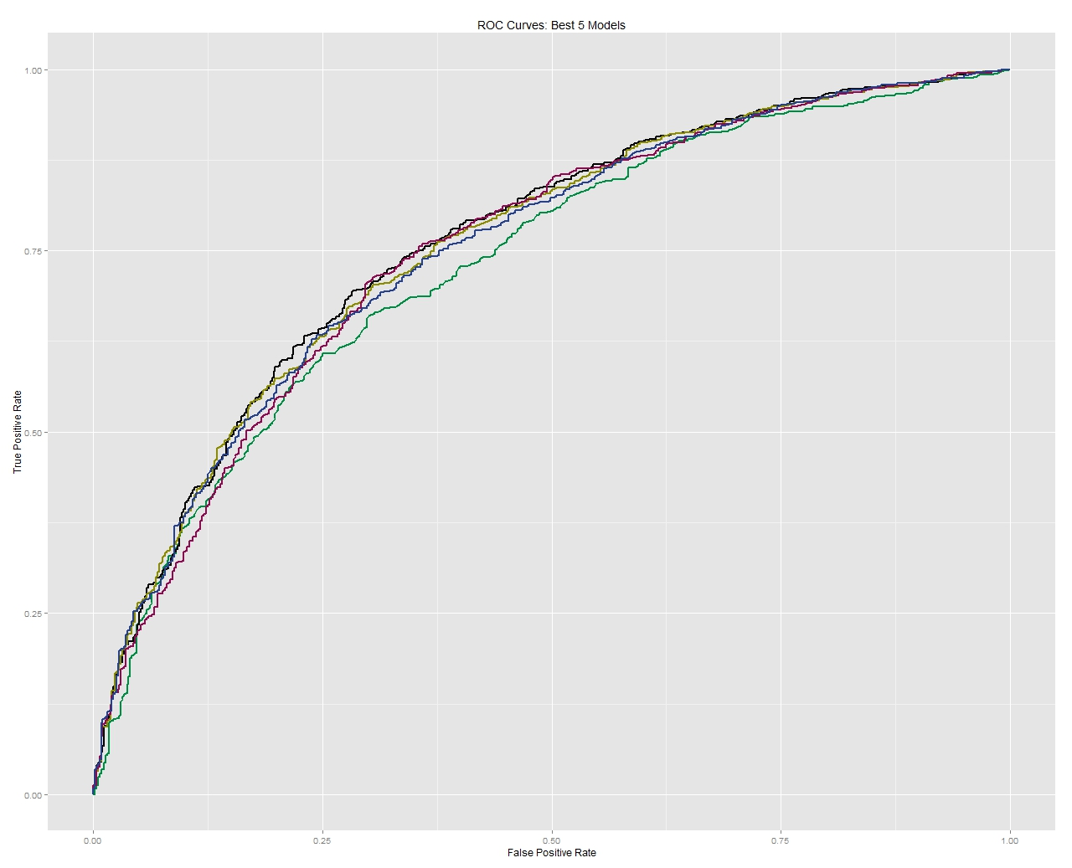
Ensemble Method
Ensemble Method | Results
As observed, the best 5 models (in terms of the AUC values) follow a similar trend and have a similar shape.
Hence, no possible leverage can be derived from ensemble model.`
Gradient Boosting Machine
Random Forest
Support Vector Machine
Naïve Bayes
Logistic Regression

Slide 33
Ensemble Method
Ensemble Method | Results
As discussed above, ensemble method do not provide any additional advantage over the individual models
In fact, ensemble method degrades the AUC of the best model (Gradient Boosting Machine)
Top 5 models from Ensemble Method (Based on Test AUC)
Logistic Regression | Decision Tree | Random Forest | GBM | SVM | LDA | Naïve Bayes | Test Error | AUC (Test Set)
X | X | X |  | X | X | X | 30.3% | 0.763
X | X | X |  |  | X | X | 30.8% | 0.761
X | X | X |  |  | X |  | 29.1% | 0.761
X | X | X |  |  |  |  | 29.4% | 0.760
X | X | X |  |  | X |  | 29.3% | 0.759
However, in terms of test error, an ensemble of GBM, SVM, and Naïve Bayes performs better than just GBM

Slide 34
Appendix

Slide 35
Determination of Significant Variables
Significant Variables
Top 16 variables were selected based on their relative strength of prediction, as determined from machine learning methods like Random Forests and Gradient Boosting Machines
Variable | Description
Age | Age (derived from ‘YOB’ variable)
EducationLevel | Education Level
Income | Income
Party | Party
HouseholdStatus | House Hold Status
Q118237 | Do you feel like you are "in over-your-head" in any aspect of your life right now
Q101162 | Are you generally more of an optimist or a pessimist
Q107869 | Do you feel like you're "normal"
Q119334 | Did you accomplish anything exciting or inspiring in 2013
Q102906 | Are you currently carrying a grudge against anyone in your personal life
Q102289 | Does your life feel adventurous
Q121011 | Changing or losing a job, getting married or divorced, the death of a close relative, moving, a major health issue, bankruptcy...all are life events that can create high stress for people. Have you experienced any of these in 2013
Q120014 | Are you more successful than most of your high-school friends
Q98869 | Does life have a purpose
Q108855 | Do you enjoy getting together with your extended family
Q115610 | Does the "power of positive thinking" actually work
Personal Attributes
Question Based

